Slide 1
Leaders of Freedom
Moulana Hasrat Muhani
Muhammad Shoaib Akhter Qadri 02-131212-009

Slide 2
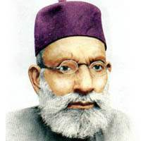
Introduction of Moulana Hasrat Mohani
Moulana Hasrat Mohani was born 4 Oct 1878 in Mohan UP.
He passed B.A by Aligarh University in 1903.
After getting education, he served his life for the nation, poetry and freedom.
He published his booklet “Urdu e Muallah” in 1903 for awake the nation and Freedom.

Slide 3
British and Freedom
Urdu e Muallah:
Islam
The freedom of Bharat
Khilafat
Result:
Prison
charged 500 rupees because of his booklet.

Slide 4
Politics for Freedom
He participated in Politics.
Battle of Tarablas,Balkan.
He joined All-India Muslim League in 1914.
Prison
He managed meeting of AIML in AhmadNagar.
He addressed about sacrifice and voilance in his presential address.

Slide 5
Completer Independence (Inqelab Zindabad)
An independence activist also known for his poetic work.
“Inquilab Zindabad” a well known slogan of revolutionist during independence movement was coined in 1921.
He was first person in Indian History who demanded “Complete Independence” in 1921.
He was died in 1951.

Slide 6
Thank You

